Slide 1
Impressions from ICSE 2013 International Conference on Software Engineering May 18 – 26, 2013, San Francisco, California, USA
Klaus Bothe
13th Workshop “Software Engineering Education and Reverse Engineering”
Bansko, Bulgaria, 26th - 31st August 2013

Slide 2
Contents
Background and overview
Some statistics: main points of the conference
Some selected papers of ICSE 2013
Impressions from CSEET
Organization: proceedings, commercials, sponsors
Conference location: San Francisco, weather, sight seeing/tourism, Berkeley, Stanford

Slide 3
Particular importance of ICSE
Premier league (first football league at England)

Slide 4
Notes:
Prinzip: alle 2 Jahre in den USA

Slide 5
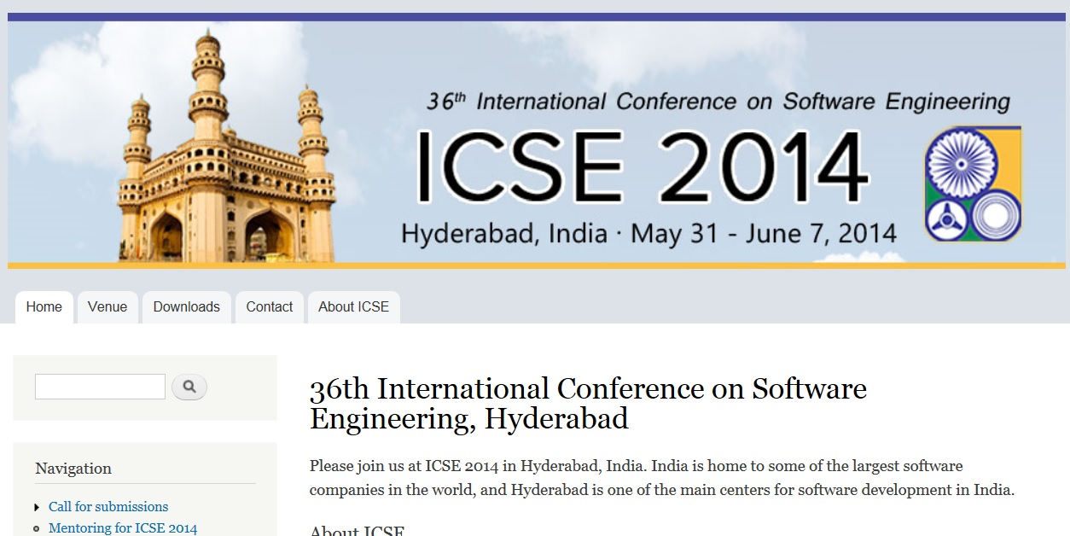
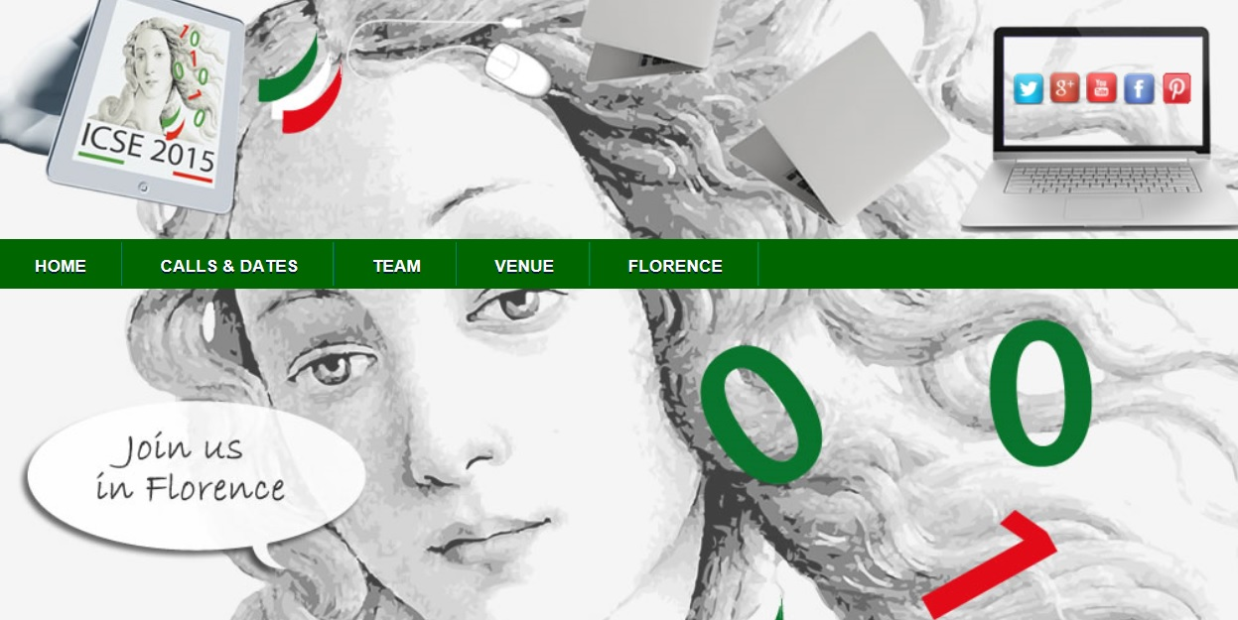
ICSE 2014 and 2015

Slide 6
ICSE 2013 Proceedings Cover

Slide 7
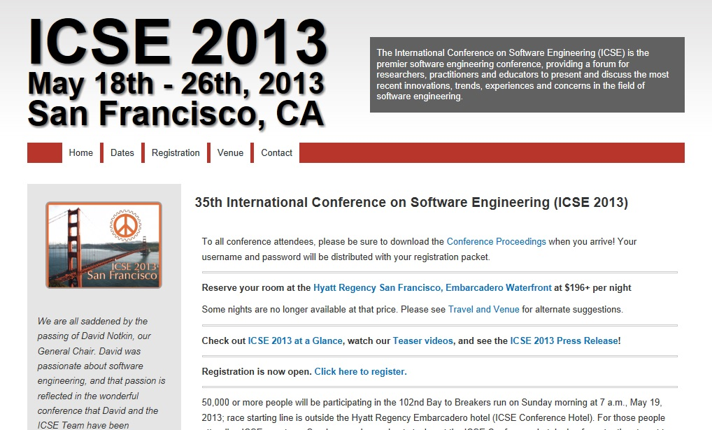
Fees (late):
ICSE 825 $
CSEET 550 $
Workshops 350 – 550 $
Toturial 500 $
Most participants ever at ICSE: 1400
Whole event:
9 days
ICSE 3 days
CSEET 3 days
Co-located events:
3 conferences
29 workshops
10 tutorials
Visit to Silicon Valley (Intel,CISCO, Electric Cloud)
Social events:
Reception
Dinner on cruise to Golden Gate Bridge

Slide 8
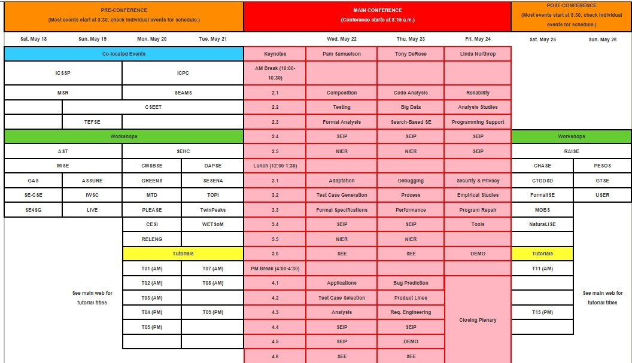
Schedule: ICSE 2013 and pre-/-post events
ICSE
Conferences
Workshops
Tutorials

Slide 9
Contents
Background and overview
Some statistics: main points of the conference
Some selected papers of ICSE 2013
Impressions from CSEET
Organization: proceedings, commercials, sponsors
Conference location: San Francisco, weather, sight seeing/tourism, Berkeley, Stanford

Slide 10
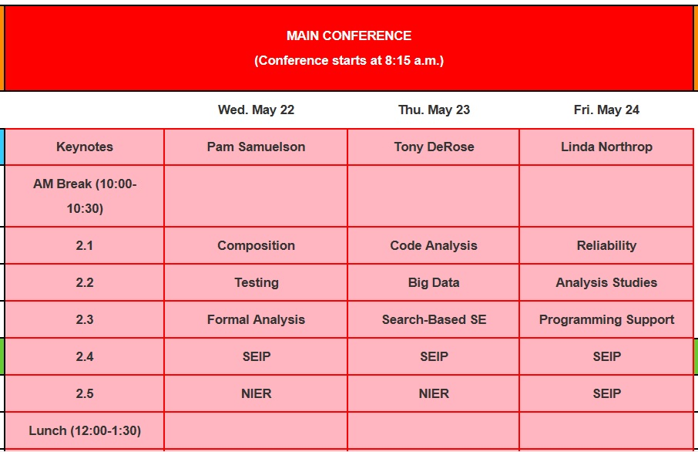
Structure of ICSE 2013: 5 – 6 parallel sessions

Slide 11
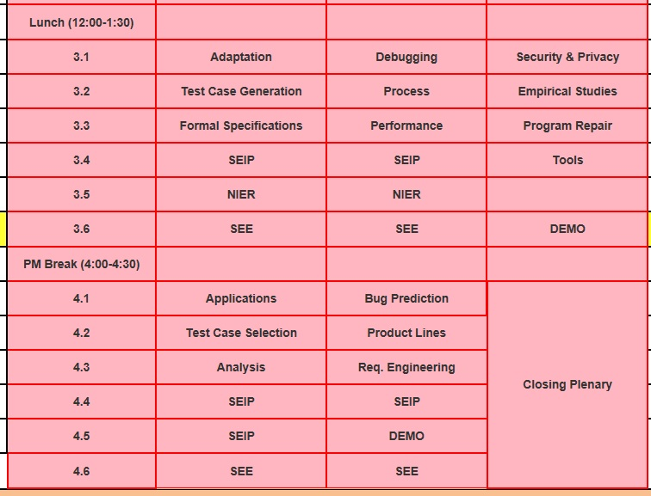
Structure of ICSE 2013: 5 technical parts
Research
SEIP:
Software Engineering in Practice
NIER:
New Ideas and Emerging Results
DEMO:
Demonstrations
SEE:
Software Engineering Education

Slide 12
ICSE
Acceptance rate: Research: 85 selected out of 461 submitted (18.5%)
SEIP (20 out of 100)
SEE (13 out of 49)
NIER (31 out of 162)
Total number of presentations: 149 papers
Awards

Slide 13
Focus of topics (Research)
24 Sessions (Research):
1. Composition
2. Testing
3. Formal Analysis
4. Adaptation
5. Test-Case Generation
6. Formal Specification
7. Applications
8. Test-Case Selection
-------------------------
9. Code Analysis
10 Big Data
11. Search-Based SE
12. Debugging
13. Process
14. Performance
15. Bug Prediction
16. Product Lines
17. Requirements Engineering
-------------------------
18. Reliability
19. Analysis Studies
20. Programming Support
21. Security and Privacy
22. Empirical Studies
23. Program Repair
24. Tools
Fields:
Requirements
Design
Coding
Testing and Debugging
Theory
Project managment
(others)

Slide 14
Focus of topics (Research)
Testing and Debugging: 21 %
Applications, Studies, Tools
7. Applications
10. Big Data
11. Search-Based SE
22. Empirical Studies
24. Tools
Applications, Studies, Tools: 21%
Quality of Software: 17 %
Quality of Software
14. Performance
18. Reliability
19. Analysis Studies
21. Security and Privacy
Design: 8%
Coding: 8%
Maintenance: 8%
Theory 8%
Requirements: 4%
Project Management: 4%
(personal classification)

Slide 15
Focus of topics (Research)
Requirements
17. Requirements Engineering
Theory
3. Formal Analysis
6. Formal Specification
Project Management
13. Process
Design
4. Adaptation
16. Product Lines
Quality of Software
14. Performance
18. Reliability
19. Analysis Studies
21. Security and Privacy
Coding
9. Code Analysis
20. Programming Support
Testing and Debugging
2. Testing
5. Test-Case Generation
8. Test-Case Selection
12. Debugging
15. Bug Prediction
Applications, Studies, Tools
7. Applications
10. Big Data
11. Search-Based SE
22. Empirical Studies
24. Tools
Maintenance
1. Composition
23. Program Repair
(personal classification)

Slide 16
Contents
Background and overview
Some statistics: main points of the conference
Some selected papers of ICSE 2013
Impressions from CSEET
Organization: proceedings, commercials, sponsors
Conference location: San Francisco, weather, sight seeing/tourism, Berkeley, Stanford

Slide 17
Examples from Testing

Slide 18
Example Papers from Testing
Testing and Debugging – 5 sessions
- 20 papers
2. Testing (3 papers)
5. Test-Case Generation (4 papers)
8. Test-Case Selection (3 papers)
12. Debugging (4 papers)
15. Bug Prediction (3 papers)

Slide 19
Testing: complete list of 20 papers
Testing
Observable Modified Condition/Decision Coverage Michael Whalen, Gregory Gay, Dongjiang You, Mats P. E. Heimdahl, and Matt Staats (University of Minnesota, USA; KAIST, South Korea)
Creating a Shared Understanding of Testing Culture on a Social Coding Site Raphael Pham, Leif Singer, Olga Liskin, Fernando Figueira Filho, and Kurt Schneider (Leibniz Universität Hannover, Germany; UFRN, Brazil)
Billions and Billions of Constraints: Whitebox Fuzz Testing in Production Ella Bounimova, Patrice Godefroid, and David Molnar (Microsoft Research, USA)
(one of 5 sessions)

Slide 20
Testing: complete list of 20 papers
Test-Case Generation
Feedback-Directed Unit Test Generation for C/C++ using Concolic Execution Pranav Garg, Franjo Ivancic, Gogul Balakrishnan, Naoto Maeda, and Aarti Gupta (University of Illinois at Urbana-Champaign, USA; NEC Labs, USA; NEC, Japan)
A Learning-Based Method for Combining Testing Techniques Domenico Cotroneo, Roberto Pietrantuono, and Stefano Russo (Università di Napoli Federico II, Italy; Lab CINI-ITEM Carlo Savy, Italy)
Human Performance Regression Testing Amanda Swearngin, Myra B. Cohen, Bonnie E. John, and Rachel K. E. Bellamy (University of Nebraska-Lincoln, USA; IBM Research, USA)
Guided Test Generation for Web Applications Suresh Thummalapenta, K. Vasanta Lakshmi, Saurabh Sinha, Nishant Sinha, and Satish Chandra (IBM Research, India; Indian Institute of Science, India; IBM Research, USA)

Slide 21
Testing: complete list of 20 papers
Test-Case Selection
Comparing Multi-point Stride Coverage and Dataflow Coverage Mohammad Mahdi Hassan and James H. Andrews (University of Western Ontario, Canada)
Interaction-Based Test-Suite Minimization Dale Blue, Itai Segall, Rachel Tzoref-Brill, and Aviad Zlotnick (IBM, USA; IBM Research, Israel)
Bridging the Gap between the Total and Additional Test-Case Prioritization Strategies Lingming Zhang, Dan Hao, Lu Zhang, Gregg Rothermel, and Hong Mei (Peking University, China; University of Texas at Austin, USA; University of Nebraska-Lincoln, USA)

Slide 22
Testing: complete list of 20 papers
Debugging
The Design of Bug Fixes Emerson Murphy-Hill, Thomas Zimmermann, Christian Bird, and Nachiappan Nagappan (North Carolina State University, USA; Microsoft Research, USA)
PorchLight: A Tag-Based Approach to Bug Triaging Gerald Bortis and André van der Hoek (UC Irvine, USA)
Expositor: Scriptable Time-Travel Debugging with First-Class Traces Yit Phang Khoo, Jeffrey S. Foster, and Michael Hicks (University of Maryland, USA)
Chronicler: Lightweight Recording to Reproduce Field Failures Jonathan Bell, Nikhil Sarda, and Gail Kaiser (Columbia University, USA)

Slide 23
Testing: complete list of 20 papers
Bug Prediction
Does Bug Prediction Support Human Developers? Findings from a Google Case Study Chris Lewis, Zhongpeng Lin, Caitlin Sadowski, Xiaoyan Zhu, Rong Ou, and E. James Whitehead Jr. (UC Santa Cruz, USA; Google, USA; Xi'an Jiaotong University, China)
Transfer Defect Learning Jaechang Nam, Sinno Jialin Pan, and Sunghun Kim (Hong Kong University of Science and Technology, China; Institute for Infocomm Research, Singapore)
It's Not a Bug, It's a Feature: How Misclassification Impacts Bug Prediction Kim Herzig, Sascha Just, and Andreas Zeller (Saarland University, Germany)

Slide 24
Structured testing: impoved MC/DC
Observable Modified Condition/Decision Coverage Michael Whalen, Gregory Gay, Dongjiang You, Mats P. E. Heimdahl, and Matt Staats (University of Minnesota, USA; KAIST, South Korea)
Remarks:
Relevance to JCSE: Structured testing
MC/DC coverage is testing standard in American aviation industry *)
Outcome of the paper: It still needs practical improvement
*) Source: RTCA, Inc. document DO-248B and EUROCAE document ED-94B “Final Report for Clarification of DO-178B (/ED-12B) ‘Software Considerations In Airborne Systems and Equipment Certification’”, 2001

Slide 25
Random testing by Microsoft
Billions and Billions of Constraints: Whitebox Fuzz Testing in Production Ella Bounimova, Patrice Godefroid, and David Molnar (Microsoft Research, USA)
Remarks:
Relevance to JCSE: Motivation of testing at big companies
1 undedected bug at Microsoft → several 100 Mio of Dollars → permanent testing
Fuzzy testing searches for test cases and finds 1000s of bugs
Automated testing required

Slide 26
Structured testing: coverage
Feedback-Directed Unit Test Generation for C/C++ using Concolic Execution Pranav Garg, Franjo Ivancic, Gogul Balakrishnan, Naoto Maeda, and Aarti Gupta (University of Illinois at Urbana-Champaign, USA; NEC Labs, USA; NEC, Japan)
Remarks:
Relevance to JCSE: structured testing, coverage degrees
Abstract (excerpt):
“In industry, software testing and coverage-based metrics are the predominant techniques to check correctness of software. This paper addresses automatic unit test generation for programs written in C/C++. The main idea is to improve the coverage obtained by feedback-directed random test generation methods, by utilizing concolic execution on the generated test drivers …”

Slide 27
Regression testing for GUI
Human Performance Regression Testing Amanda Swearngin, Myra B. Cohen, Bonnie E. John, and Rachel K. E. Bellamy (University of Nebraska-Lincoln, USA; IBM Research, USA)
Remarks:
Relevance to JCSE: GUI testing
Abstract (excerpt):
“As software systems evolve, new interface features such as keyboard shortcuts and toolbars are introduced. While it is common to regression test the new features for functional correctness, there has been less focus on systematic regression testing for usability, due to the effort and time involved in human studies. Cognitive modeling tools such as CogTool provide some help by computing predictions of user performance, but they still require manual effort to describe the user interface and tasks, limiting regression testing efforts. In recent work, we developed CogTool Helper to reduce the effort required to generate human performance models of existing systems …”

Slide 28
Structured testing: branch coverage
Comparing Multi-point Stride Coverage and Dataflow Coverage Mohammad Mahdi Hassan and James H. Andrews (University of Western Ontario, Canada)
Remarks:
Relevance to JCSE: structured testing: branch coverage
Abstract (full):
“We introduce a family of coverage criteria, called Multi-Point Stride Coverage (MPSC). MPSC generalizes branch coverage to coverage of tuples of branches taken from the execution sequence of a program. We investigate its potential as a replacement for dataflow coverage, such as def-use coverage. We find that programs can be instrumented for MPSC easily, that the instrumentation usually incurs less overhead than that for def-use coverage, and that MPSC is comparable in usefulness to def-use in predicting test suite effectiveness. We also find that the space required to collect MPSC can be predicted from the number of branches in the program.”

Slide 29
Test-suite minimization
Interaction-Based Test-Suite Minimization Dale Blue, Itai Segall, Rachel Tzoref-Brill, and Aviad Zlotnick (IBM, USA; IBM Research, Israel)
Remarks:
Relevance to JCSE: testing is expensive → minimal test suites
Abstract (full):
“Combinatorial Test Design (CTD) is an effective test planning technique that reveals faults resulting from feature interactions in a system. The standard application of CTD requires manual modeling of the test space, including a precise definition of restrictions between the test space parameters, and produces a test suite that corresponds to new test cases to be implemented from scratch. In this work, we propose to use Interaction-based Test-Suite Minimization (ITSM) as a complementary approach to standard CTD. ITSM reduces a given test suite without impacting its coverage of feature interactions. ITSM requires much less modeling effort, and does not require a definition of restrictions. It is appealing where there has been a significant investment in an existing test suite, where creating new tests is expensive, and where restrictions are very complex. We discuss the tradeoffs between standard CTD and ITSM, and suggest an efficient algorithm for solving the latter. We also discuss the challenges and additional requirements that arise when applying ITSM to real-life test suites. We introduce solutions to these challenges and demonstrate them through two real-life case studies

Slide 30
What is a real bug?
It's Not a Bug, It's a Feature: How Misclassification Impacts Bug Prediction Kim Herzig, Sascha Just, and Andreas Zeller (Saarland University, Germany)
Remarks:
Relevance to JCSE: What is a bug?
Abstract (full):
“In a manual examination of more than 7,000 issue reports from the bug databases of five open-source projects, we found 33.8% of all bug reports to be misclassified---that is, rather than referring to a code fix, they resulted in a new feature, an update to documentation, or an internal refactoring. This misclassification introduces bias in bug prediction models, confusing bugs and features: On average, 39% of files marked as defective actually never had a bug. We discuss the impact of this misclassification on earlier studies and recommend manual data validation for future studies.”

Slide 31
Testing management
Creating a Shared Understanding of Testing Culture on a Social Coding Site Raphael Pham, Leif Singer, Olga Liskin, Fernando Figueira Filho, and Kurt Schneider (Leibniz Universität Hannover, Germany; UFRN, Brazil)
Remarks:
Relevance to JCSE: Motivation of testing management
Testing has to be introduced systematically at social development sites – distributed open source development (e.g. GitHub)
Many employees, changing staff
TESTING CULTURE: test automation, existing test suites to be adapted to own problems, guidelines, education, tutorials, discussions are necessary

Slide 32
Empirical Studies

Slide 33
UML in practice
UML in Practice Marian Petre (Open University, UK)
ACM SIGSOFT
Distinguished Paper
Remarks:
Relevance to JCSE: UML and its relevance
Abstract (full):
“UML has been described by some as "the lingua franca" of software engineering. Evidence from industry does not necessarily support such endorsements. How exactly is UML being used in industry if it is? This paper presents a corpus of interviews with 50 professional software engineers in 50 companies and identifies 5 patterns of UML use.”
lingua franca: main technical communication language

Slide 34
UML in practice
Five patterns of using UML:
No UML (35/50);
Retrofit (1/50): don’t really use UML, but retrofit UML in order to satisfy management or comply with customer requirements;
Automated code generation (3/50): UML is not used in design, but is used to capture the design when it stabilizes, in order to generate code automatically (typically in the context of product lines);
Selective (11/50): UML is used in design in a personal, selective, and informal way, for as long as it is considered useful, after which it is discarded;
Wholehearted (0/50 – but described in secondary reports): organizational, top-down introduction of UML, with investment in champions, tools and culture change, so that UML use is deeply embedded.

Slide 35
UML in practice
TABLE I. DECLARED CURRENT UML USE AMONG 50 PROFESSIONAL
SOFTWARE DEVELOPERS FROM 50 COMPANIES.
Category of UML Use | Instances of Declared
no UML | 35
retrofit | 1
automated code generation | 3
selective | 11
wholehearted | 0

Slide 36
UML in practice: problems
From 1st category
Companies used it – but often not successfully …
„… they have considered it, often having adopted it for a project or two, and found that it did not offer them advantages over their current, evolved practices and representations.”
Question unanswered: current practices and representations?
„What was good about UML was not new, and what was new about UML was not good.”

Slide 37
UML in practice: problems
Companies used it – but not successfully because of …
Complexity
Issues of transformation and coordination between views
Lack of formal semantics
From 1st category
“UML is a graphical representation. There is no check on consistency,
redundancy, completeness or quality of the model what so ever.”
“Modeling a small project may not be a problem, but handling large projects in UML forces you to go over the entire model every time you want to change anything, to see what the consequences for the rest of the model will be.”

Slide 38
UML in practice: problems
Companies used it – but not successfully because of …
Complexity
Issues of transformation and coordination between views
Lack of formal semantics
Lack of separation of expressions of structure and behavior
Conclusions:
- UML at education?
- UML at JCSE? ☹

Slide 39
UML at education?
„… but there are also practices that employ UML effectively in
reasoning about and communicating about design, both
individually and in collaborative dialogues”
(conclusion part of this paper).
What about other subjects at industry?
Systematic testing
Software architecture
Design patterns
Formal specifications
Petri nets
…
Are there alternatives, e.g. for modeling a software system?

Slide 40
Contents
Background and overview
Some statistics: main points of the conference
Some selected papers of ICSE 2013
Impressions from CSEET
Organization: proceedings, commercials, sponsors
Conference location: San Francisco, weather, sight seeing/tourism, Berkeley, Stanford
CSEET:
Conference on Software Engineering Education and Training

Slide 41
CSEET: subjects
Subjects: SE curricula, projects, processes (incl. Agile methods at courses), testing, architecture …
(Educational) Projects, projects, projects … to motivate students and gain experience; students projects: real-life, with industry, team-work, social abilities …

Slide 42
CSEET Tutorial on Testing
No programming without testing
http://web-cat.org/cseet2013/
Stephen Edwards, Virginia Tech University

Slide 43
Project „Ensemble“: a JCSE-related project for teaching materials
NSF supported (National Science Foundation)
Digital library of all computing education materials
SWENET (Collection of SE course materials of 6 US universities -American JCSE☺) has been included as one of the collections in Ensemble
Greg Hislop (co-project leader): encourages us to making JCSE visible through Ensemble (needs meta data of JCSE)
http://computingportal.org/

Slide 44
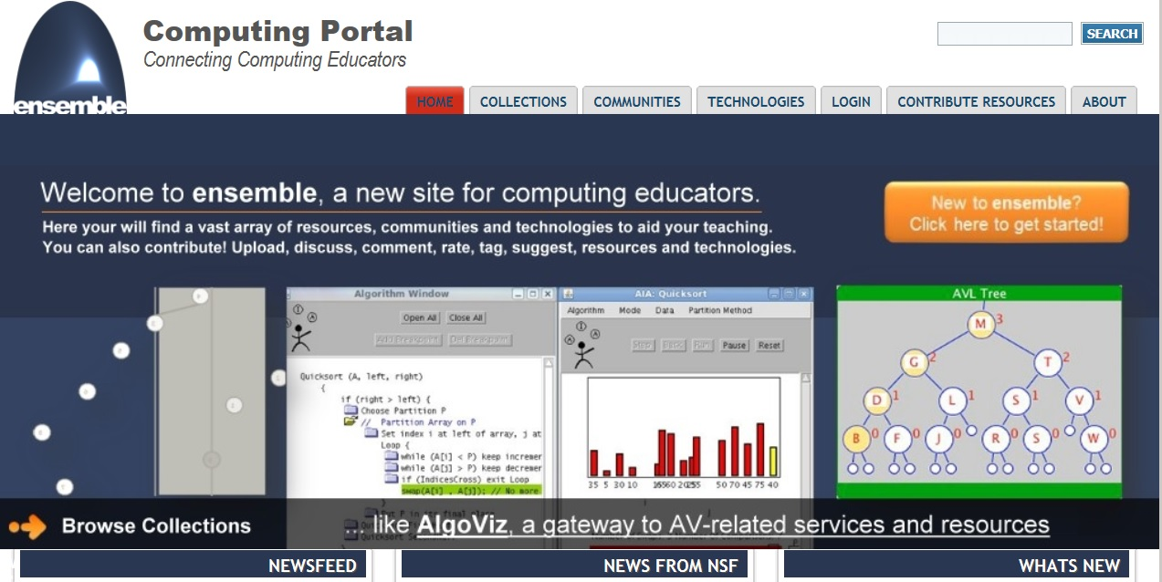
Ensemble website

Slide 45
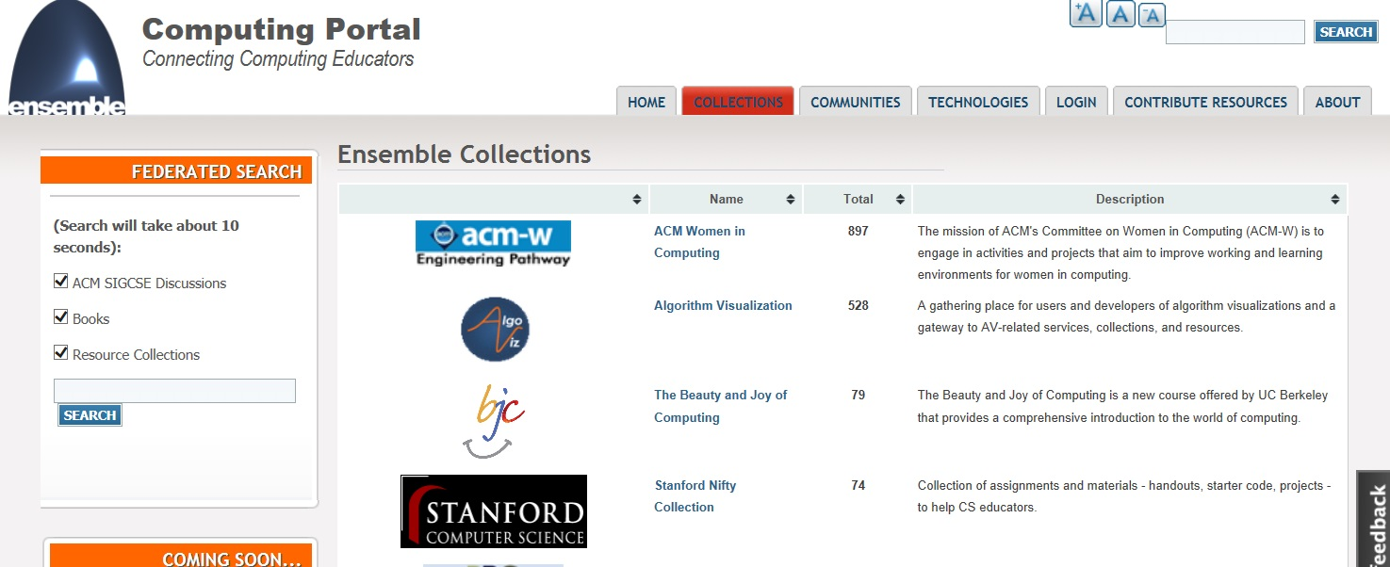
Ensemble: some examples

Slide 46
Contents
Background and overview
Some statistics: main points of the conference
Some selected papers of ICSE 2013
Impressions from CSEET
Organization: proceedings, sponsors
Conference location: San Francisco, weather, sight seeing/tourism, Berkeley, Stanford

Slide 47
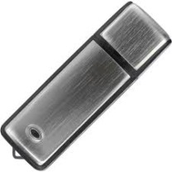
ICSE Proceedings
http://...
User name:
Password:
512 MByte
10 years ago:
Book
2005:
CD
2010:
USB Stick
2013:
Protected Website and download

Slide 48
Sponsors

Slide 49
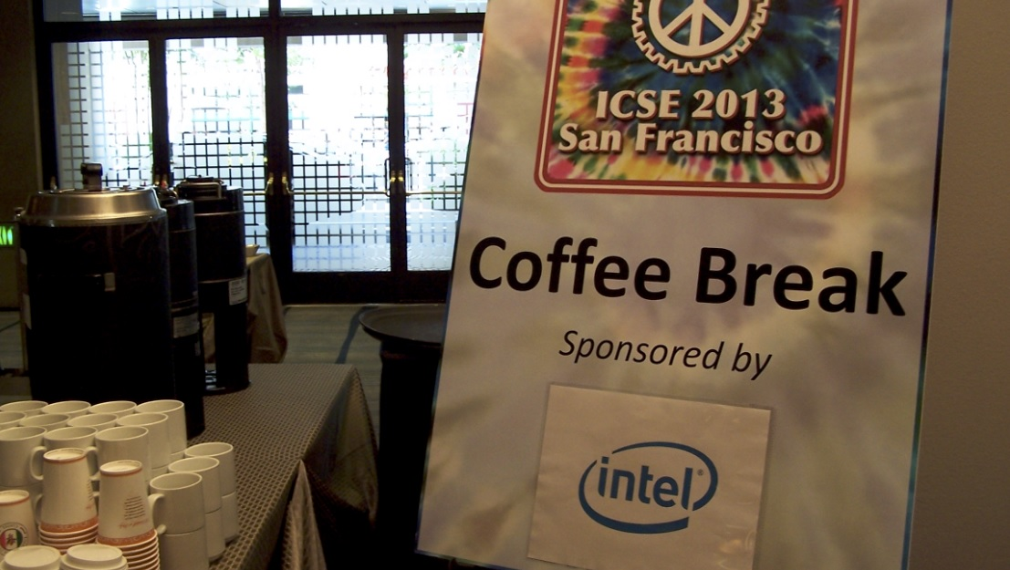
Sponsors

Slide 50
Sponsors

Slide 51
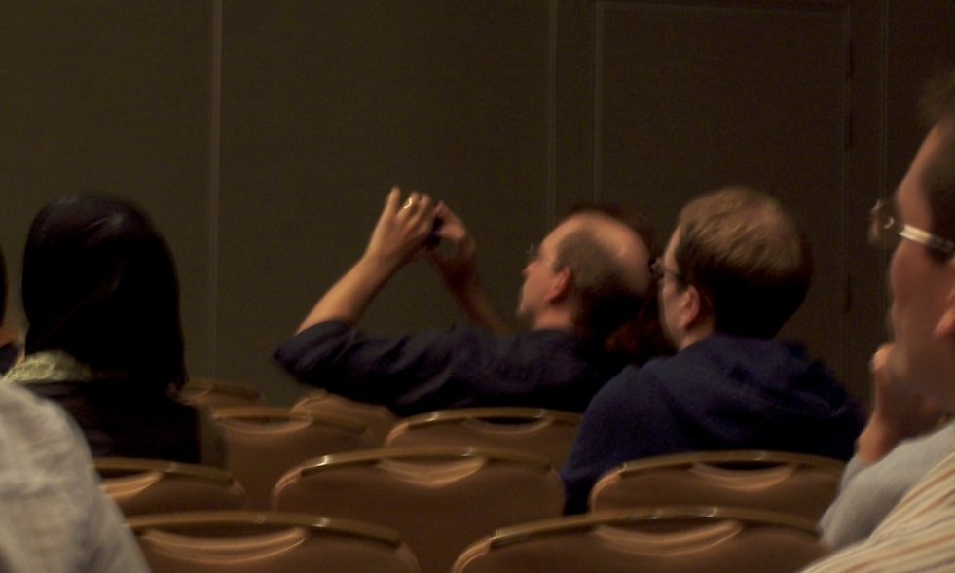
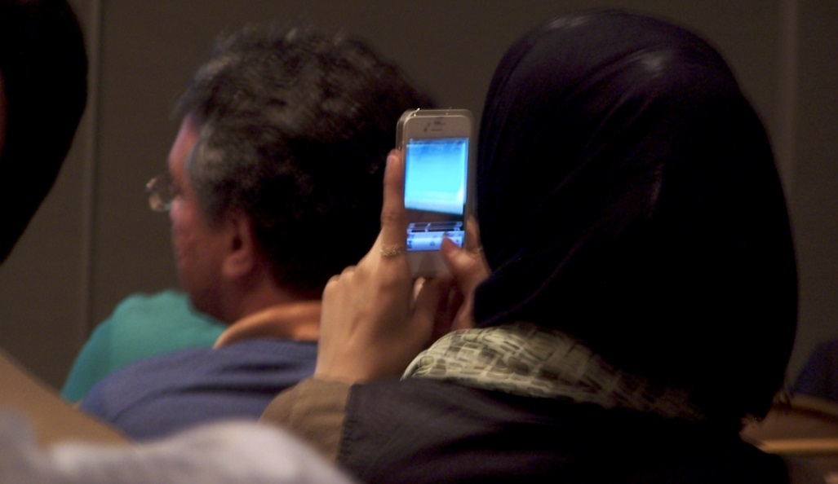
Participants behaviour ☺
… taking pictures of slides

Slide 52
Slide: each picture correctly referenced

Slide 53
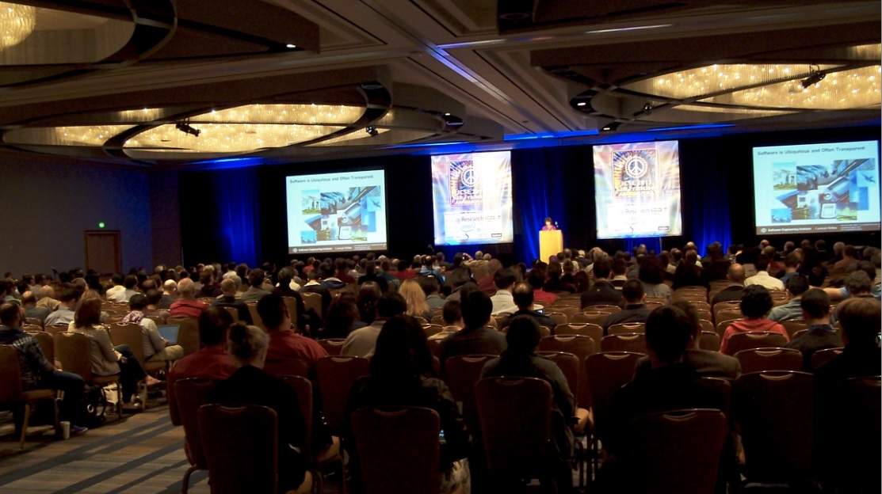
Big conference room

Slide 54
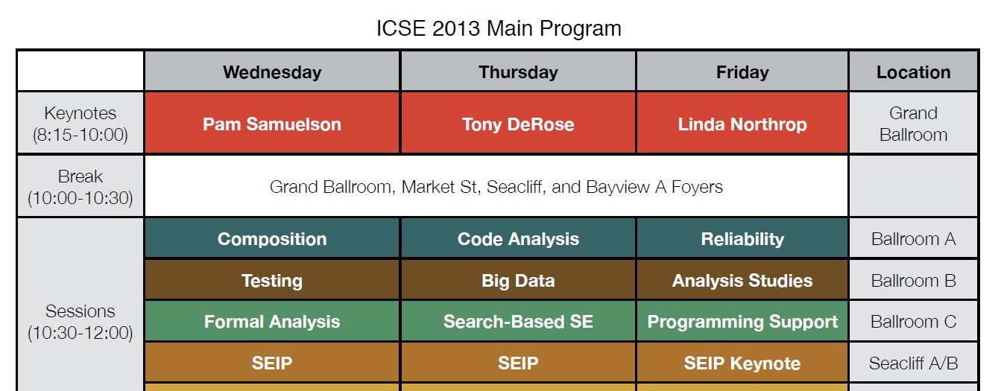
Start time in the morning

Slide 55
Contents
Background and overview
Some statistics: main points of the conference
Some selected papers of ICSE 2013
Impressions from CSEET
Organization: proceedings, commercials, sponsors
Conference location: San Francisco, weather, sight seeing/tourism, Berkeley, Stanford

Slide 56
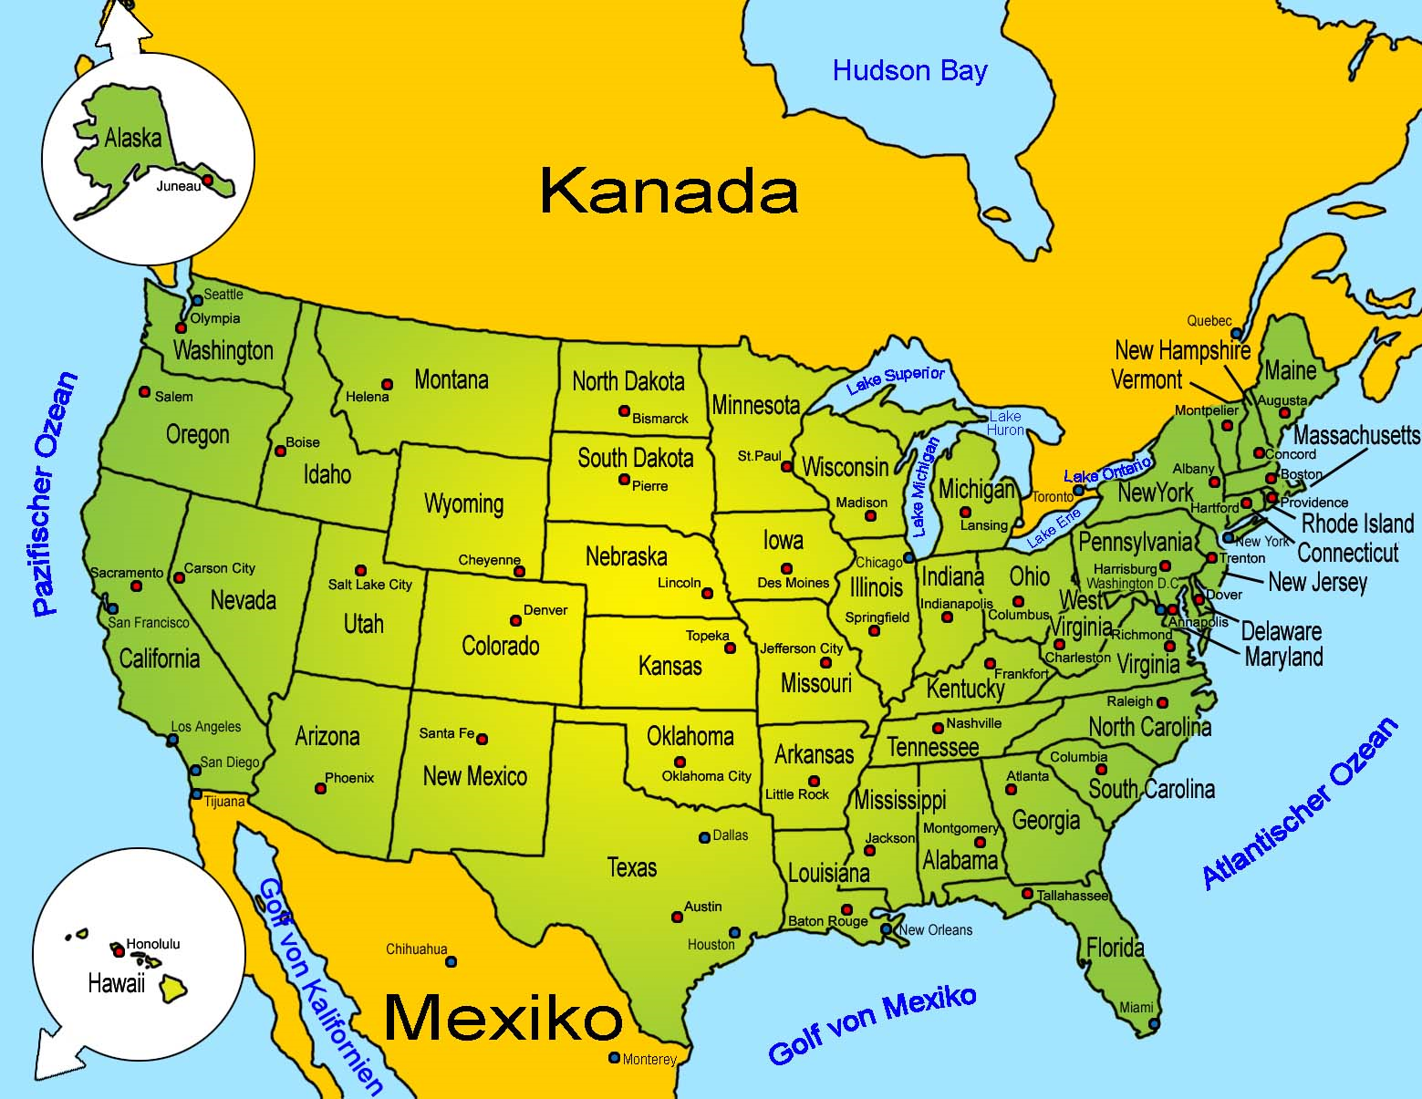
Location of San Francisco

Slide 57
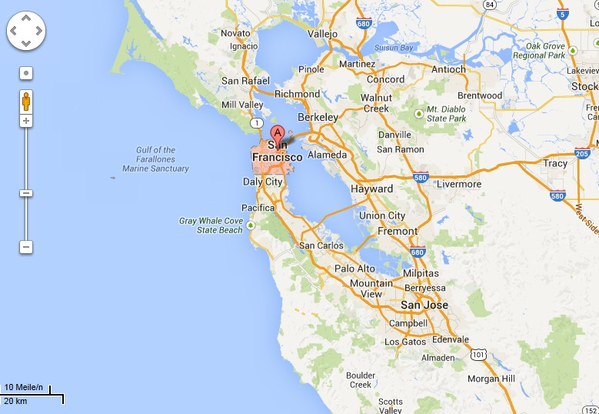
Environment of San Francisco
Berkeley University
Golden Gate Bridge
Standford University

Slide 58
Golden gate bridge

Slide 59
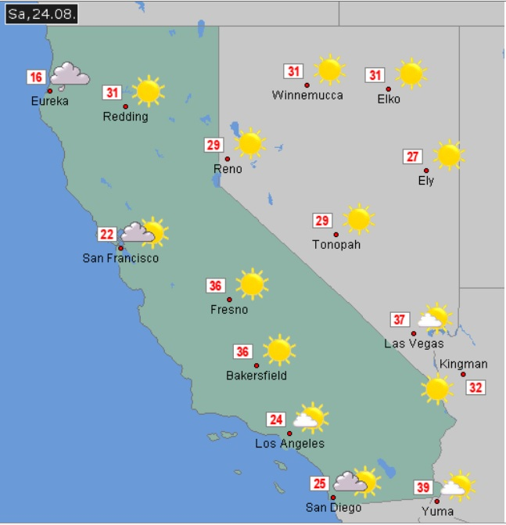
Climate, air temperature
Mark Twain:
The coldest winter I ever saw was the summer I spent in San Francisco.
Temperatures on 24th Aug 2013

Slide 60
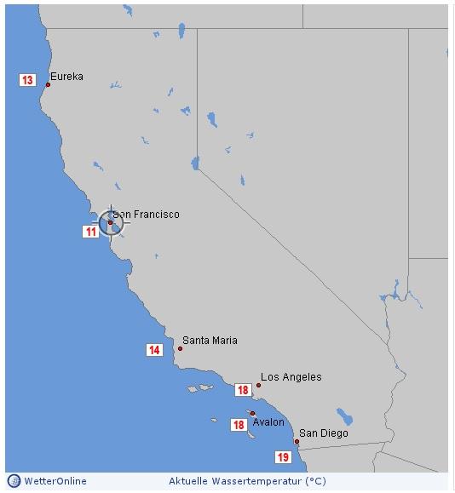
Climate, water temperature
Mark Twain:
The coldest winter I ever saw was the summer I spent in San Francisco.
Water temperatures on 1st June 2013

Slide 61
Down Town

Slide 62
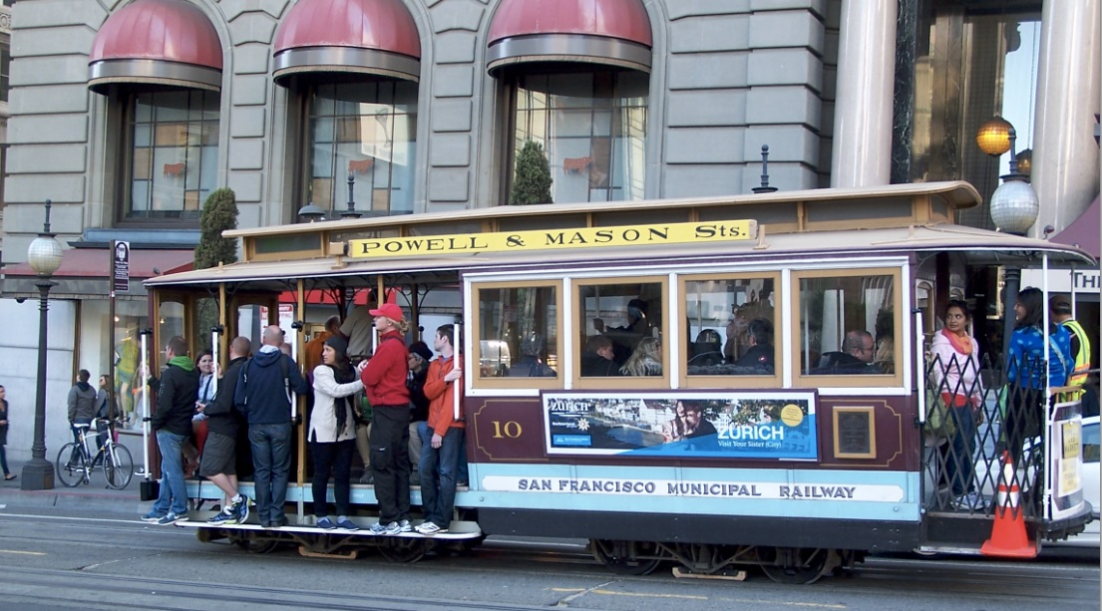
Cable car

Slide 63
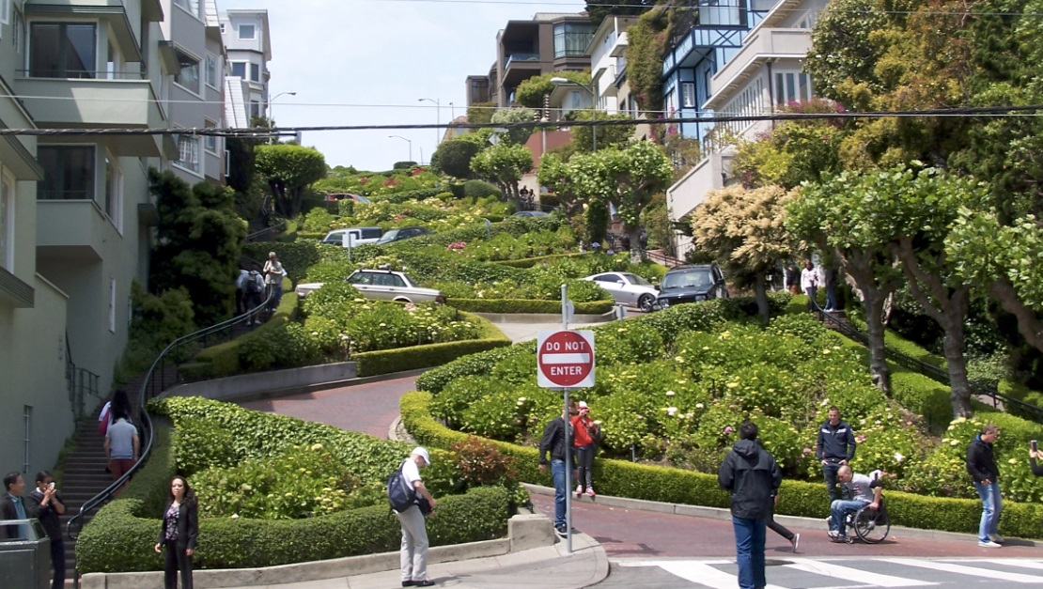
Lombard Street

Slide 64
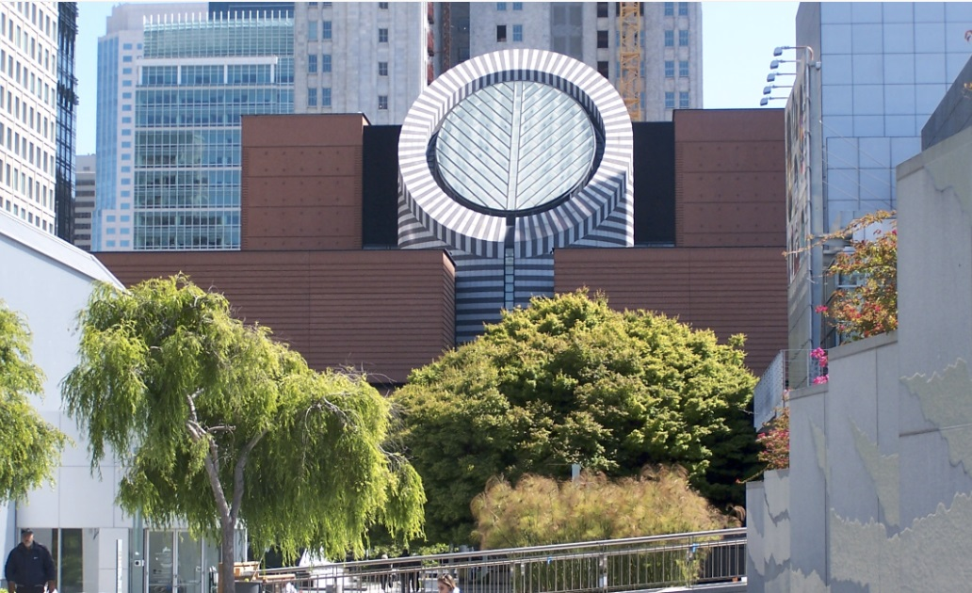
Museum of Modern Art

Slide 65
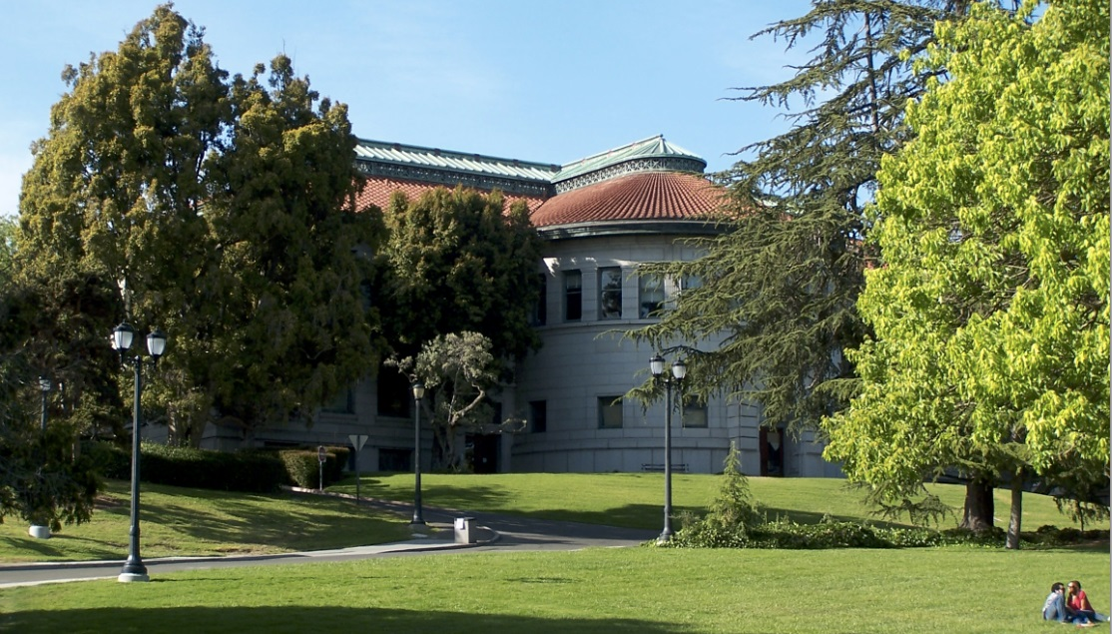
Berkeley: University campus

Slide 66
Conclusion
Intstead of one presentation „Impressions from ICSE 2013“
several ones would have been possible:
Technical trends in Software Engineering at ICSE 2013
Research trends in software testing
Teaching material platform „Ensemble“
Teaching practices for SE presented at CSEET
Introduction to programming for beginners emphasizing testing
UML in practice
and
San Francisco as a touristic attraction

Slide 67
Thank you …

